Slide 1

Poornima Institute of Engineering & Technology
TEAM NAME: HEX
PROJECT ID: 8CS PR 2018_19_17
STUDENTS NAME:
1. Abhishek Sharma
2. Ankit Kumawat
3. Lokesh Choudhary
Project Guide By: Mr. Deepak Moud
Department of Computer Engineering PIET , Jaipur
Signature Varification in Air

Slide 2
Vision of Department
Department of computer engineering shall create an environment in which new ideas, research and technology grows and form which technocrats and innovators of tomorrow come forward to face the global challenges. It aims at being recognized globally as role model and be a part of substantial natural resources.

Slide 3
Mission of Department
To develop competent professional with innovative mind set, problem solving, design and implementation skills through excellent under graduate education.
To provide platform to students so that they can expertise themselves as a computer professional, entrepreneurs or as a manager while fulfilling their ethical and social responsibility in a globally competitive environment.
To contribute significantly to the research and discovery of new arenas of methods and knowledge in the field of computer engineering.

Slide 4
Index
Objectives
Introduction
Product Backlog
Sprint Backlog-I
Sprint Backlog-II
Sprint Backlog-III
Sprint Backlog-IV
Results
Conclusion and Future Scope

Slide 5
Objectives
Signature verification is a technique used by banks, intelligence agencies and high-profile institutions to validate the identity of an individual.
Aim of this project is to design an algorithm, which can distinguish between genuine and forged signatures in organizations like in banks on cheques.
We are developing a solution for this by using machine-learning methods to validate the authenticity of an individual's signature.

Slide 6
Introduction
Today almost in every organizations whether it is private or public, signatures are used to check authenticity of that person. This process is done manually which consumes human resources.
We are developing a solution for this by using machine-learning methods to validate the authenticity of an individual's signature.
The system take signature of the person without physical interaction using camera, perform signature verification, and display the results.

Slide 7
Product Backlog
The flow of project is converted into the form of product backlog to make the process easier into divided tasks and estimated time.
There are 3 types of users in this project-
Developer
User
Database admin

Slide 8
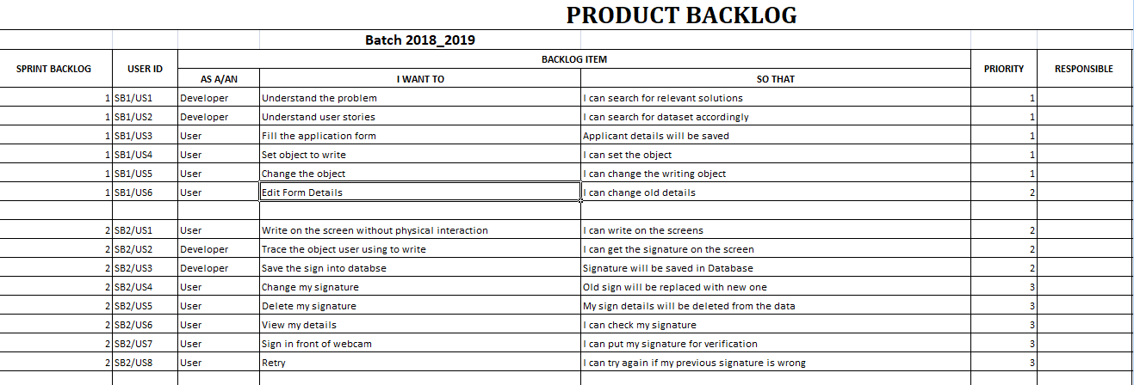
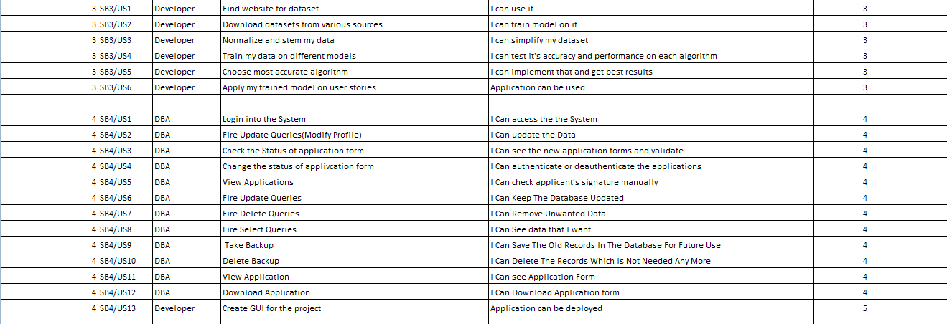

Slide 9
Sprint Backlog -1
In this phase all the perquisites for the project are gathered.
Search for other relevant solutions for the project analysing the similar projects.
Then a web form is developed to take the details of user.
Design a database schema for the project and create databases to store the data of each user. Read about the concepts and methods.

Slide 10
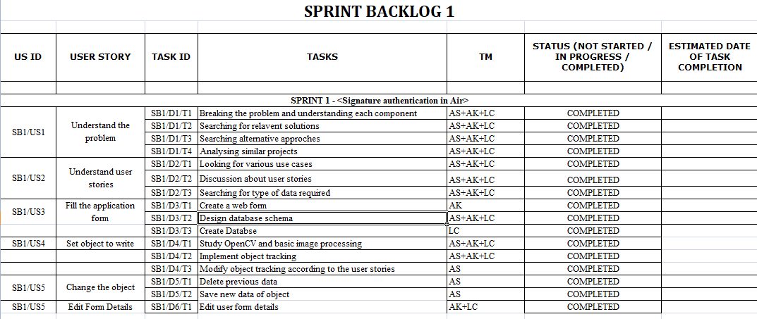

Slide 11
Sprint Backlog -2
In this phase we developed the application where user can write using the webcam.
You don’t need any physical device for writing on screen simply write on the air
Store the data which is written on the screen and any modification can be done or data can be deleted if it will not require.
User can modifies his details.

Slide 12
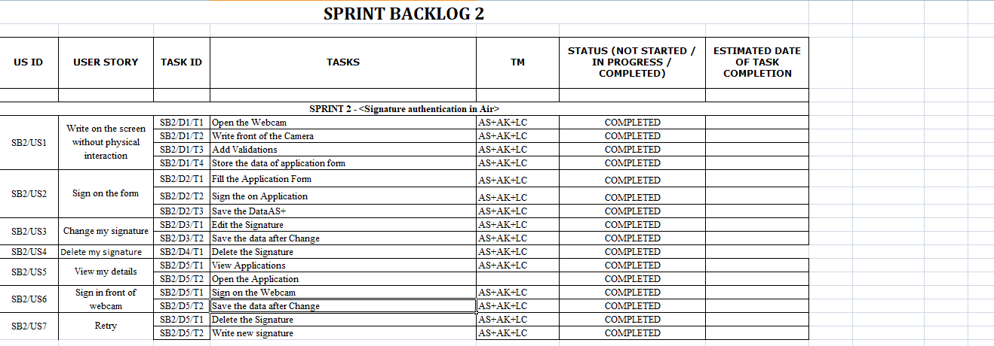

Slide 13
Sprint Backlog -3
In this phase we download the datasets from various websites (kaggle.com, github) and this dataset for the project.
This dataset apply on various data models and check the accuracy .
The model chooses the higher accuracy and applies on the data set which is downloaded from the websites.
Data normalization is the process of rescaling one or more
We apply different DL models on Standard Datasets and store the results.

Slide 14
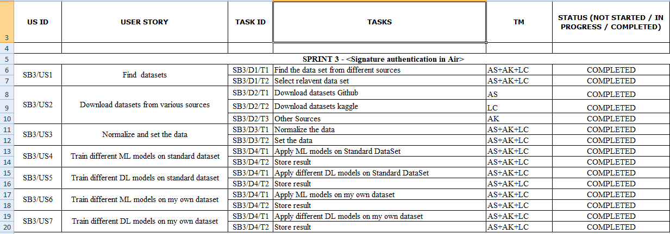

Slide 15
Sprint Backlog -4
In this phase we compare all the data models and choose the data model which is having higher accuracy.
We make own datasets and apply on the data models and see the accuracy is same as on downloaded dataset.
For same accuracy we normalize the own datasets by transforming and rescaling the data.
Check the status of data model and improved the dataset for more accurate results.
Implement it for all users.

Slide 16
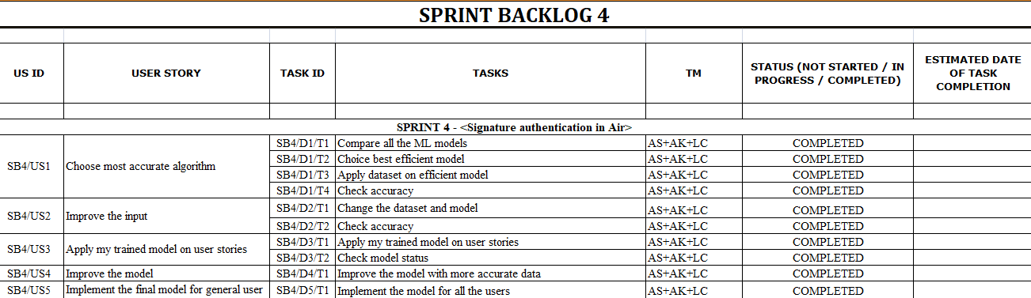

Slide 17
Results
We have successfully developed the application for signature authentication. This application provides a hassle free authentication without physical interaction with the device. There are various stages through which it is developed and last a complete project including graphical user interface is developed.
This project is developed to identify the forged signature.

Slide 18
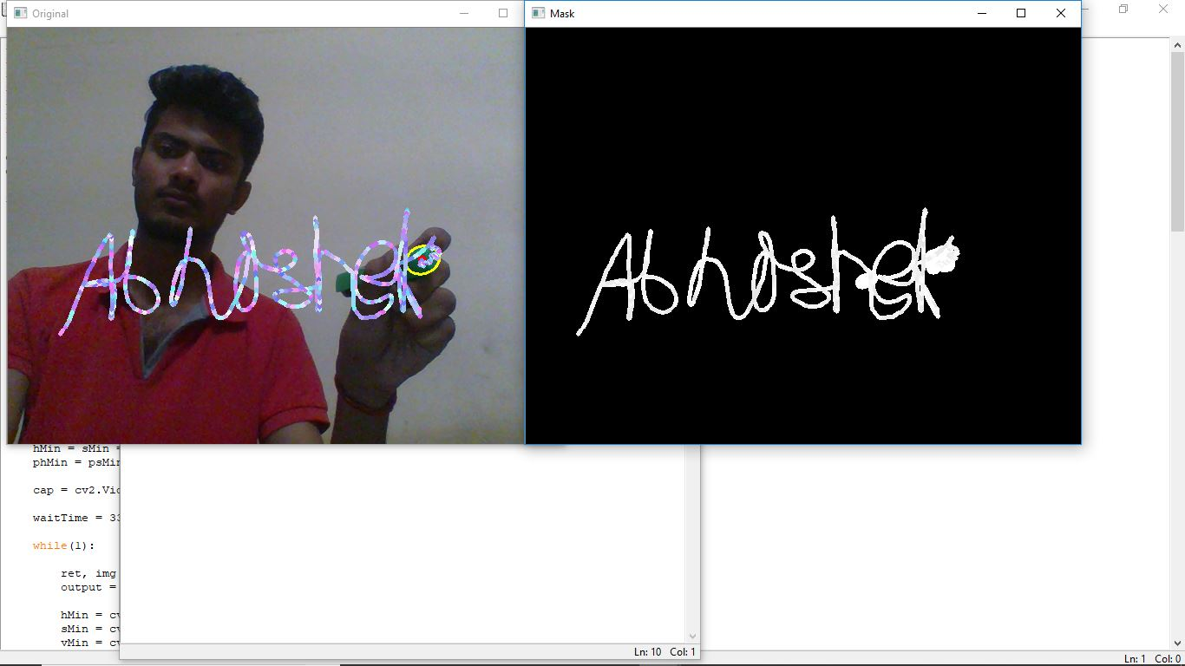
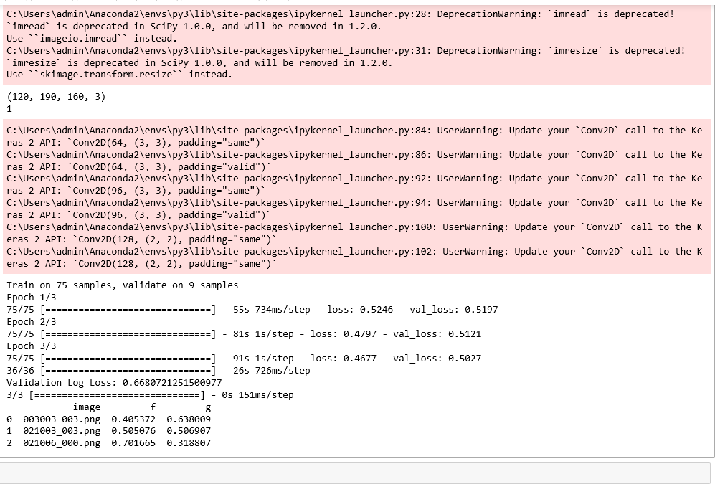
Screenshots of project

Slide 19
Conclusion and Future Scope
In this era the authentication of persons is most important because every day we see the news regarding the data breaches. So for that signature authentication process is essential with other authentication process such as face and finger scanning.
So this module or application will use with the other authentication processes to get the better results and avoid breaches.

Slide 20

Thanks

